Slide 1
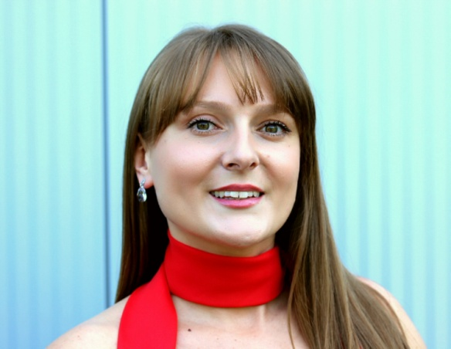
Tijana Milenković (Beč)
Institut za slavistiku
Univeziteta u Beču
tijana.milenkoviceva@gmail.com
Ježurka Ježić svetom luta
u deset fantastičnih filmskih minuta
8. Simpozijum: Ćopić fantаstični
Novi Sad, 8–10. novembar 2018.

Slide 2
Sadržaj:
1) Adaptacija teksta Ćopićeve „Ježeve kućice‟
2) Lutkarski film i tehnika stop-animacije
3) Kako se stvarao animirani film „Ježeva kuća‟?
a) nacrt i izrada lutaka
b) izrada i postavljanje scenografije
c) snimanje pokreta i naracije
4) Scene iz filma
5) Učešče na festivalima i osvojene nagrade
6) Trejler za film
7) Iza scene
8) Tehnike prevođenja i kriterijumi za dobar prevod
9) Šta ima prednost: forma ili sadržaj?
8) Koliko je Ćopić fantastičan danas?
9) Izvori
10) Literatura

Slide 3
Adaptacija teksta „Ježeva kućica‟:
1) slikovnica
2) bojanka
3) audio-priča
4) audio-pesma
5) lutkarska predstava
6) igrana predstava
7) mjuzikl
8) opera
9) animirani crtani film
10) animirani lutkarski film

Slide 4
Scenario i režija: Eva Cvijanović Prema kratkoj priči Branka Ćopića Naratori: Rade Šerbedžija (hrvatska verzija), Kenneth Welsh (engleska verzija),
France Castel (francuska verzija) Muzika: Darko Rundek Direktor fotografije: Ivan Slipčević Animatori: Ivana Bošnjak, Thomas Johnson Modelovanje lutaka: Eva Cvijanović, Ivana Bošnjak, Thomas Johnson Modelovanje scenografije i rekvizita: Ivana Bošnjak, Thomas Johnson,
Kata Gugić, Dina Karadžić, Marko Meštrović Savetnik za izradu lutaka i animaciju: Tim Allen Organizator i asistent režiserke: Miroslav Šimeg Optički efekti: Elise Simard Postprodukcija: Mario Kalogjera Montaža: Eva Cvijanović, Iva Kraljević Dizajn zvuka: Olivier Calvert Tehnički direktor: Eloi Champagne Prevod: Vanda Mikšić, Evaine Le Calvé-Ivičević (francuski),
Amela Marin (engleski) Producentkinje: Jelena Popović (NFB), Vanja Andrijević (Bonobostudio) Izvršni producent: Michael Fukushima, NFB

Slide 5
Lutkarski film je vrsta animiranog filma u kojem se istim postupkom animacije pokreću lutke. Takozvana „kadar-po-kadar“ ili „stop-animacija“ jedna je od prvih animatorskih tehnika koja se koristila za izradu specijalnih efekata u filmovima. Stop animacija omogućuje stvaranje privida kretanja stvari koje su inače nepokretne i to tako što se pomoću kamere koja može snimati kadar po kadar snima željena scena, a zatim se objekat koji se treba animirati samo malo pomakne, nakon čega se snima sledeća slika i tako redom.

Slide 6
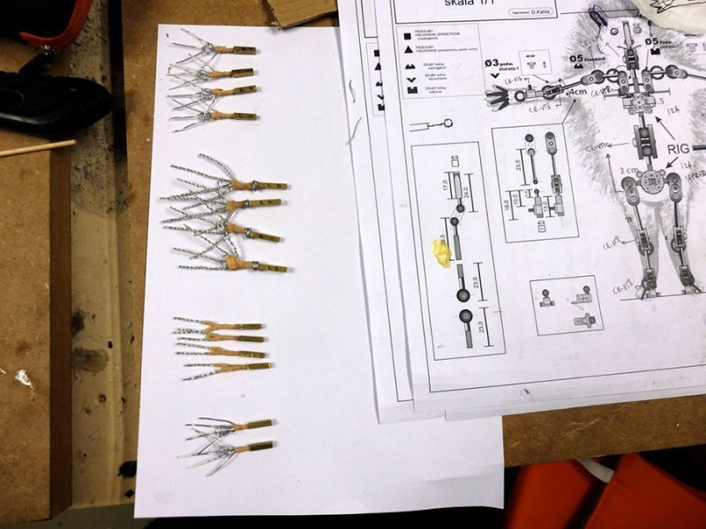
Izrada lutaka, nacrt ježa: Ivana Bošnjak (Izvor: Bonobostudio)

Slide 7
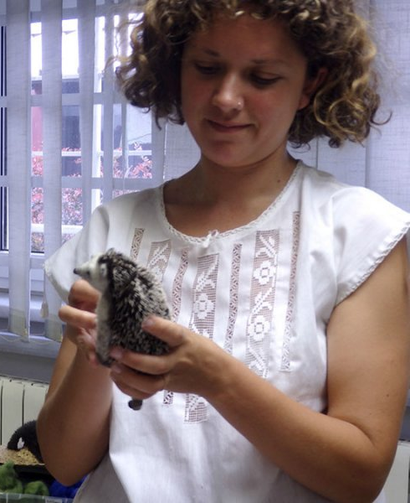
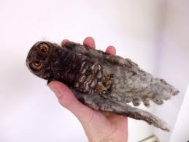
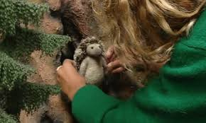
Izrada lutaka: Eva Cvijanović (Izvor: Bonobostudio)

Slide 8
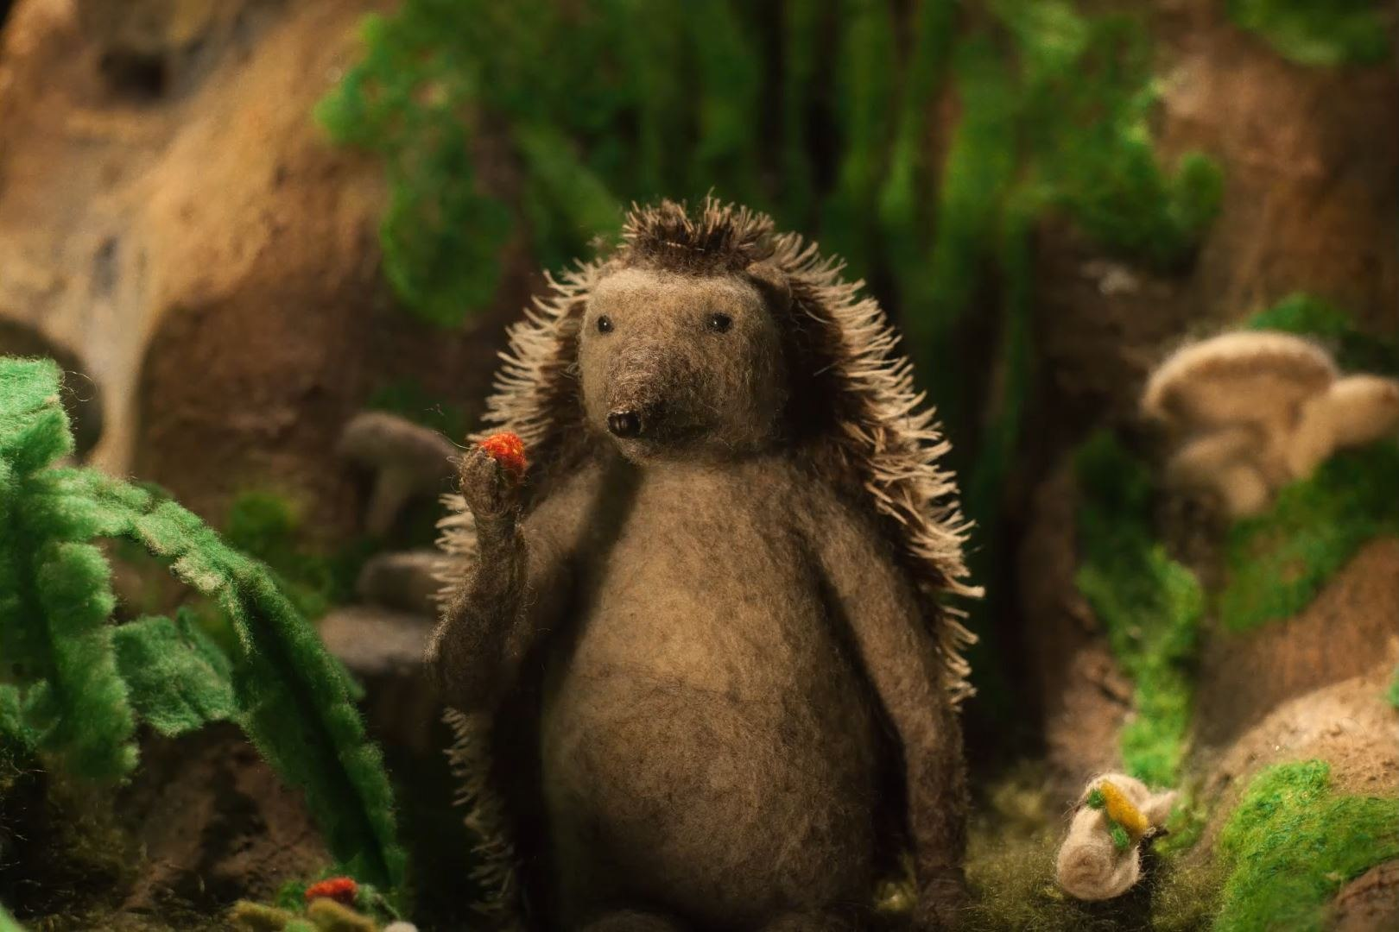
Lutka: Ježurka Ježić (Izvor: Bonobostudio)

Slide 9
Lutka: lisica (Izvor: Bonobostudio)

Slide 10
Lutke: vuk, divlja svinja, medved (Izvor: Bonobostudio)

Slide 11
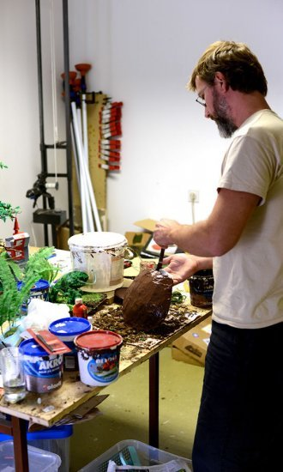
Izrada seta: Marko Meštrović (Izvor: Bonobostudio)

Slide 12
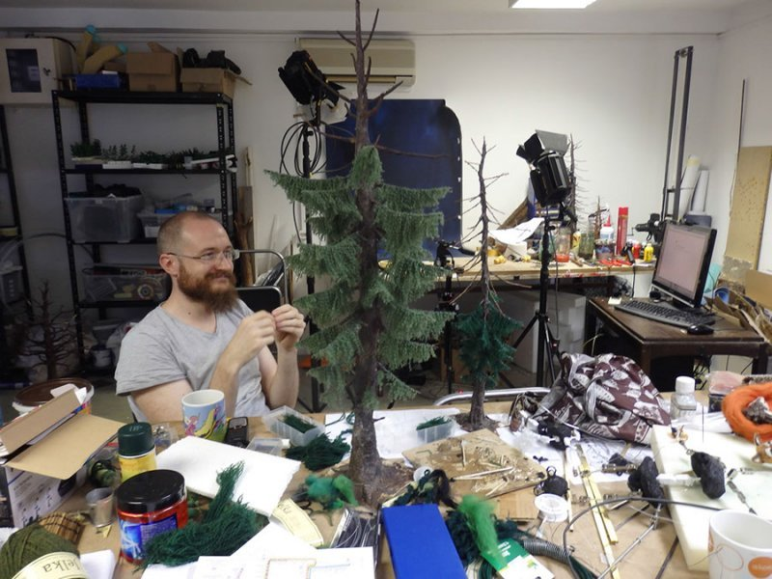
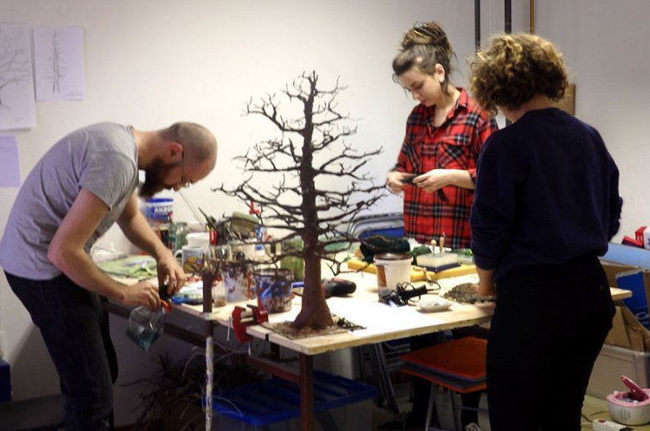
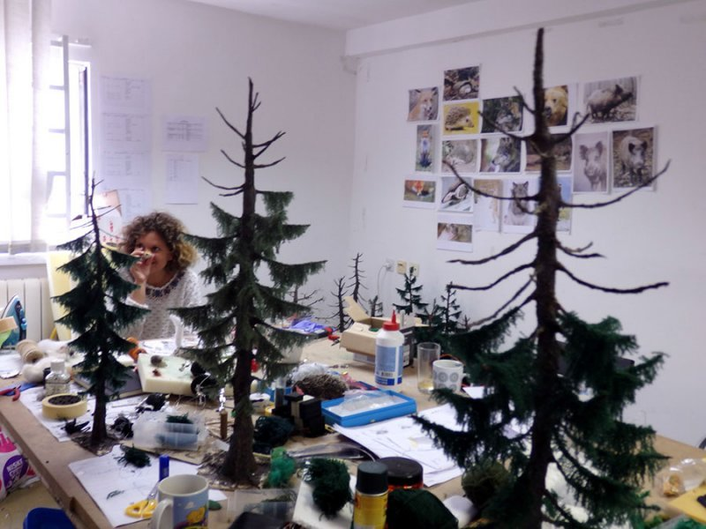
Izrada lutaka i seta, Thomas Johnson, Dina Karadžić, Kata Gugić, Eva Cvijanović

Slide 13
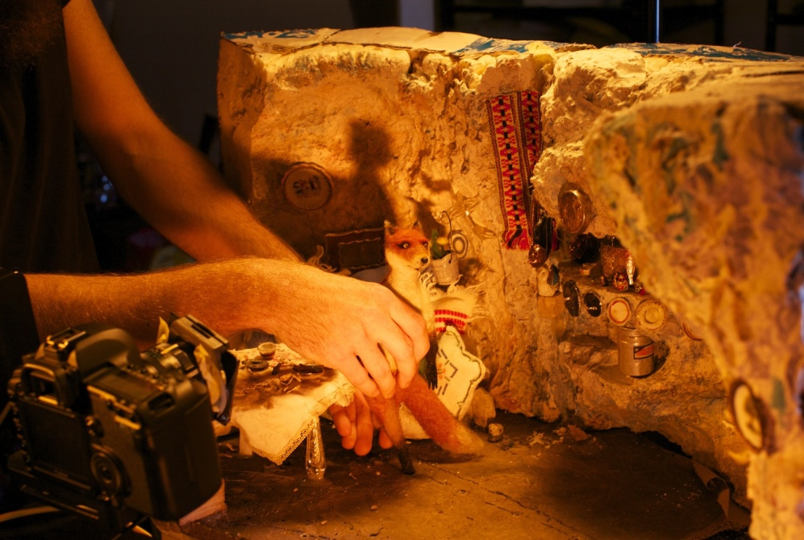
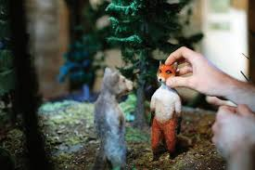
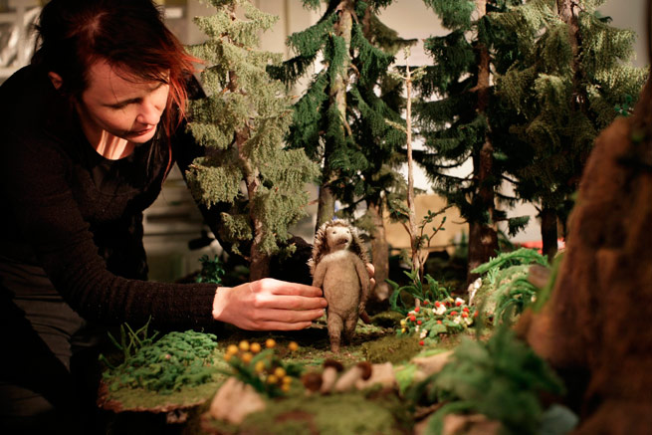
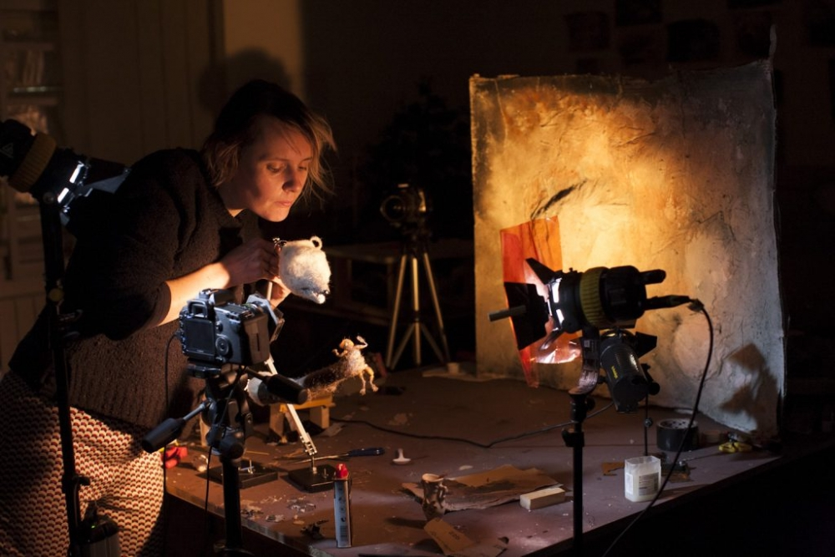
Postavljanje scene i snimanje (Izvor: Bonobostudio)

Slide 14
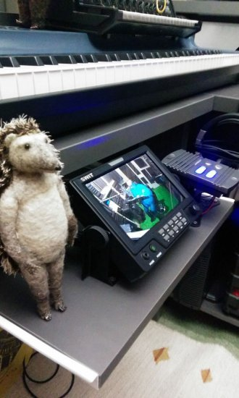
Snimanje naracije u Sarajevu: Eva Cvijanović, Rade Šerbedžija, Jelena Popović, Vanja Andrijević (Izvor: Bonobostudio)

Slide 15
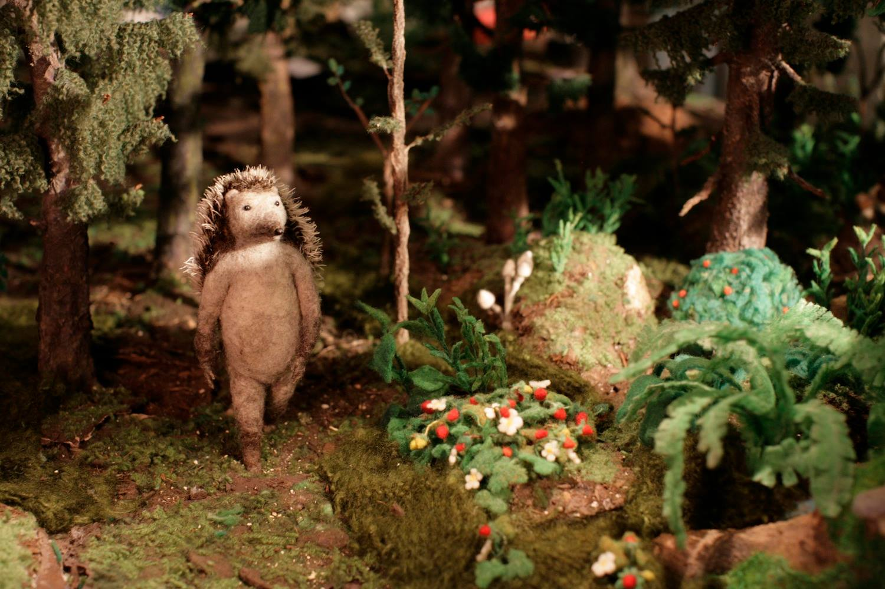
Scena iz filma: Ježurka Ježić luta po šumi (Izvor: Bonobostudio)

Slide 16
Scena iz filma: Lija piše pismo prijatelju Ježurki (Izvor: Bonobostudio)

Slide 17
Scena iz filma: Ježurka Ježić dolazi kod lije (Izvor: Bonobostudio)

Slide 18
Scena iz filma: Ježurka Ježić na večeri kod lije (Izvor: Bonobostudio)

Slide 19
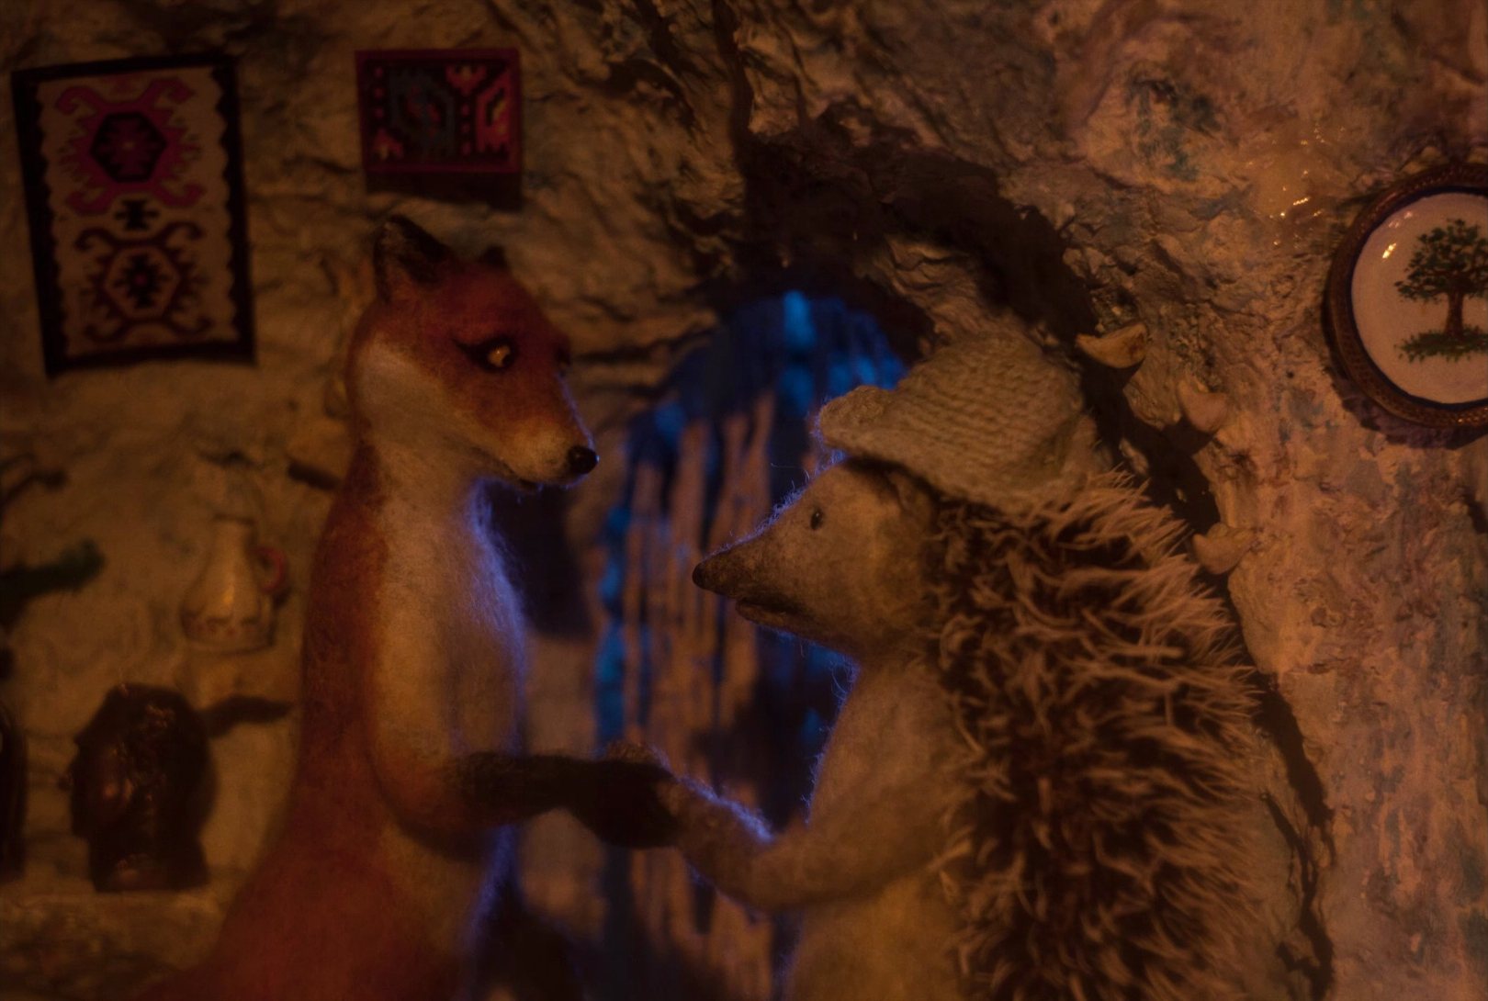
Scena iz filma: Ježurka Ježić se oprašta sa lijom (Izvor: Bonobostudio)

Slide 20
Scena iz filma: Ježurka Ježić se vraća kući (Izvor: Bonobostudio)

Slide 21
Scena iz filma: Stanovnici šume se dogovaraju da prate ježa (Izvor: Bonobostudio)

Slide 22
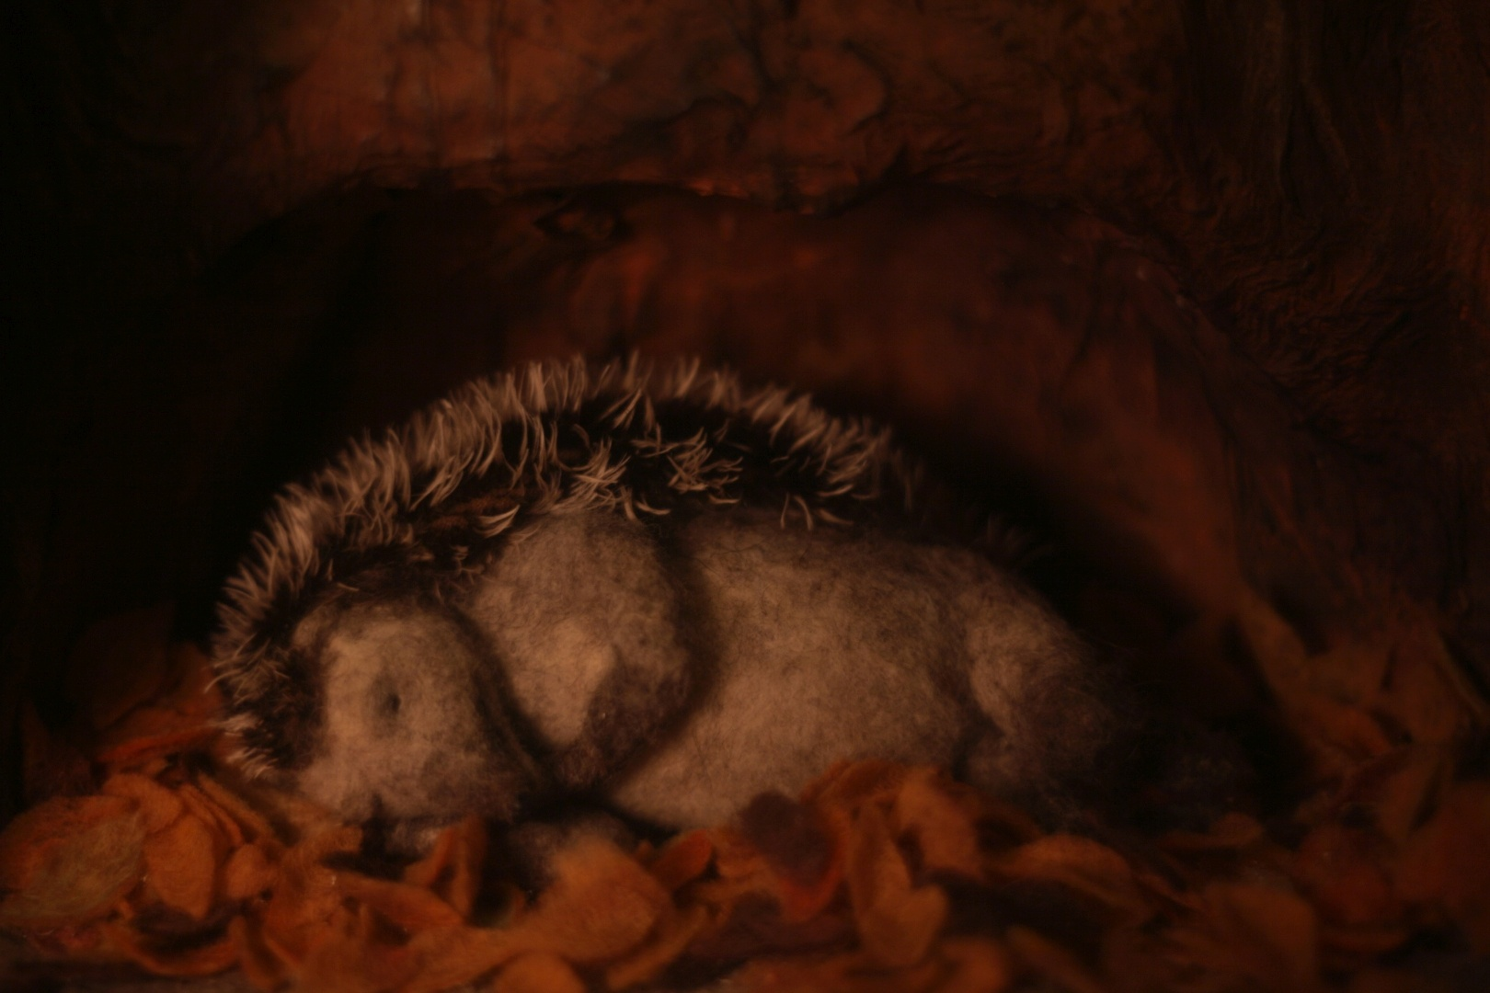
Scena iz filma: Ježurka se oseća spokojno u svom domu (Izvor: Bonobostudio)

Slide 23
Scena iz filma: Ježurka se suprotstavlja neistomišljenicima (Izvor: Bonobostudio)

Slide 24
Scena iz filma: Lija zaključuje da je Ježurka bio u pravu (Izvor: Bonobostudio)

Slide 25
Festivali Berlinale - Berlin International Film Festival (9/2-19/2/2017) Holland Animation Film Festival (22/3-26/3/2017) KIKI Međunarodni festival dječjeg filma (24/4-28/4/2017) Filmska runda (26/5-28/5/2017) Zlin Film Festival (26/5-3/6/2017) VAFI Internacionalni festival animiranog filma djece i mladih (30/5-4/6/2017) Mo&Friese Childrens Shortfilmfestival Hamburg (4/6-11/6/2017) Animafest Zagreb - Svjetski festival animiranog filma (5/6-10/6/2017) Kratki na brzinu – Revija hrvatskih kratkih filmova (6/6-11/6/2017) Festival mediteranskog filma Split (8/6-17/6/2017) Annecy International Animation Festival (12/6-17/6/2017) Dani hrvatskog filma (16/6-21/6/2017) Palm Springs International ShortFest (20/6-26/6/2017) Fest Anca International Animation Festival (29/6-2/7/2017) Tabor Film Festival (6/7-9/7/2017) Curtas Vila do Conde International Film Festival (8/7-16/7/2017) Insomnia Festival (13/7-17/7/2017) Giffoni Experience (14/7-22/7/2017)

Slide 26
Pula Film Festival (15/7-22/7/2017) Supertoon International Animation Festival (16/7-21/7/2017) Anima Mundi International Animation Festival (18/7-30/7/2017) Motovun Film Festival / Buzz@teen (20/7-23/7/2017) Guanajuato International Film Festival (21/7-30/7/2017) Postira Seaside Film Festival (26/7-30/7/2017) Kinder Film Fest Kyoto (3/8-5/8/2017) Sarajevo Film Festival (11/8-18/8/2017) Anibar International Animation Festival (14/8-20/8/2017) Ljubljana International Short Film Festival (28/8-2/9/2017) Animanima International Animation Festival (5/9-9/9/2017) Fantoche International Animation Film Festival (5/9-10/9/2017) Kinookus Food Film Festival (7/9-10/9/2017) World Festival of Animated Film, Varna (13/9-17/9/2017) Ottawa International Animation Festival (20/9-24/9/2017) Linoleum International Festival of Contemporary Animation & Media-art (28/9-1/10/2017) New York Film Festival (28/9-15/10/2017) Carrousel international du film de Rimouski (1/10-8/10/2017)

Slide 27
Balkanima European Animated Film Festival (3/10-7/10/2017) BFI London Film Festival (4/10-15/10/2017) Festival du nouveaux cinema Montreal (4/10-15/10/2017) Stoptrik International Film Festival (5/10-8/10/2017) Tofuzi International Animated Film Festival (5/10-7/10/2017) Animatou International Animation Film Festival (6/10-14/10/2017) St. John's International Women's Film & Video Festival (18/10-22/10/2017) Valladolid International Film Festival (21/10-28/10/2017) Banjaluka International Animated Film Festival (23/10-28/10/2017) Uppsala International Short Film Festival (23/10-29/10/2017) Chicago International Children's Film Festival (27/10-5/11/2017) Multivision Festival, St. Petersburg (28/10-2/11/2017) Eastern Neighbours Film Festival, Den Haag (1/11-5/11/2017) New Chitose Airport International Animation Festival (2/11-5/11/2017) Taipei Golden Horse International Film Festival (3/11-24/11/2017) Etiuda&Anima International Film Festival (21/11-26/11/2017) PÖFF Shorts, Tallinn (21/11-26/11/2017) Sommets du cinema d'animation Montreal (22/11-26/11/2017)

Slide 28
Anilogue International Animation Festival (29/11-3/12/2017) Ajyal Youth Film Festival, Doha (29/11-4/12/2017) London International Animation Festival (1/12-10/12/2017) Olympia International Film Festival (2/12-9/12/2017) Animateka International Animated Film Festival (4/12-10/12/2017) Piccolo Festival dell’Animazione (11/12-29/12/2017) Winter Apricots International Film Festival, Prilep (15/12-16/12/2017) Shortz International video and film festival, Novi Sad (21/12-22/12/2017) Flickerfest International Short Film Festival (12/1-21/1/2018) Sundance Film Festival (18/1-28/1/2018) Göteborg Film Festival (26/1-5/2/2017) Clermont-Ferrand International Short Film Festival (2/2-10/2/2018) Victoria Film Festival (2/2-11/2/2018) ANIMA - Brussels Animation Festival (9/2-18/2/2018) Portland International Film Festival (15/2-1/3/2018) Rendez-vous Québec Cinéma, Montreal (21/2-3/3/2018) FIFEM Festival International du film pour enfants, Montreal (3/3-11/3/2018) Tricky Women International Animation Film Festival (7/3-11/3/2018)

Slide 29
Monstra - Lisbon Animated Film Festival (8/3-18/3/2018) Festival Regard - Saguenay International Short Film Festival (14/3-18/3/2018) Vilnius International Film Festival (15/3-29/3/2018) GLAS Animation Festival (22/3-25/3/2018) Aspen ShortsFest, USA (3/4-8/4/2018) Bosnian-Herzegovinian Film Festival, New York (11/4-14/4/2018) Flatpack Film Festival (13/4-22/4/2018) Filmfest Dresden (17/4-22/4/2018) Prokuplje Film Festival (16/5-20/5/2018) Yorkton Film Festival (24/5-27/5/2018) REDCAT International Children's Film Festival (26/5-10/6/2018) Countryside Animafest Cyprus (19/7-21/7/2018) Novi val festival (7/9-8/9/2018) Animator Fest – European Youth Festival of Animated Film (12/9-16/9/2018) Festival Stop Motion Montreal (14/9-16/9/2018) Biennial of Animation Bratislava (8/10-12/10/2018) Primanima World Festival of First Animations (24/10-27/10/2018) Porto/Post/Doc: Film & Media Festival (24/11-2/12/2018)

Slide 30
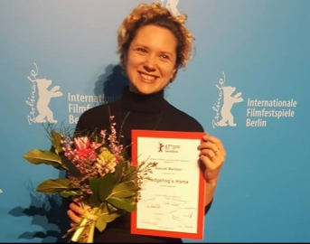
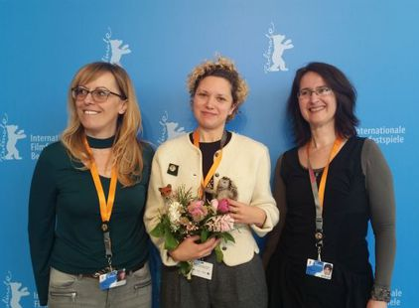
Plakat za film i nagrada na Berlinalu (Izvor: Bonobostudio)

Slide 31
Nagrade
Posebno priznanje, Berlinale 2017
Nagrada za najbolji film, KIKI Međunarodni festival dječjeg filma 2017
Prva nagrada u MIDI SENIOR kategoriji, VAFI Internacionalni festival animiranog filma djece i mladih 2017
Nagrada publike, Animafest Zagreb 2017
Posebno priznanje žirija, Animafest Zagreb 2017
Nagrada za najbolju animaciju, Revija Kratki na brzinu 2017
Nagrada publike, Festival mediteranskog filma Split 2017
Posebno priznanje, Festival mediteranskog filma Split 2017
Nagrada za najbolji film u programu za mlade Young Audiences, Annecy International Animation Festival 2017
Nagrada Oktavijan za najbolji animirani film, Dani hrvatskog filma 2017
Nagrada za najbolju glazbu, Dani hrvatskog filma 2017
Nagrada publike, Dani hrvatskog filma 2017
Grand Prix u kategoriji kratkog animiranog filma, Supertoon 2017
Grand Prix u kategoriji kratkog animiranog filma, Kinder Film Fest Kyoto 2017
Posebno priznanje, Guanajuato International Film Festival 2017
Nagrada publike, Animanima - Međunarodni festival animacije 2017
Počasno priznanje, Ottawa International Animation Festival 2017

Slide 32
Najbolji film jugoistočne Europe, Balkanima 2017
Najbolji film za djecu, Balkanima 2017
Nagrada za najbolji film u programu P'tits loups, Festival du nouveaux cinema 2017
Nagrada publike, Međunarodni festival animiranog filma Banjaluka 2017
Posebna nagrada žirija, New Chitose Airport International Animation Festival 2017
Nagrada dječjeg žirija, New Chitose Airport International Animation Festival 2017
Srebrna Hudodrakija, Etiuda&Anima 2017
Nagrada dječjeg žirija, Animateka 2017
Nagrada za najbolji zvuk, Winter Apricots International Film Festival 2017
Nagrada kritike za najbolji kratki film, Anima Brussels 2018
Nagrada Téléfilm Canada, Rendez-vous Québec Cinéma 2018
Nagrada dječjeg žirija za najbolji kratki film, FIFEM Festival International du film pour enfants 2018
Posebno priznanje, Monstra - Lisbon Animated Film Festival 2018
Nagrada publike, Monstra - Lisbon Animated Film Festival 2018
Najbolji film za djecu, GLAS Animation Festival 2018
Nagrada publike, Flatpack Film Festival 2018
Grand Prix, Animator Fest – European Youth Festival of Animated Film 2018
Nagrada Europskog saveza za djecu ECFA 2018
Posebno priznanje dječjeg žirija, Primanima World Festival of First Animations 2018

Slide 33
Hedgehog’s Home / Ježeva kuća
TEASER #1
https://vimeo.com/146548020
TEASER #2
https://vimeo.com/149624026
Teasers for a short film directed by Eva Cvijanović Based on a short story by Branko Ćopić Produced by National Film Board and Bonobostudio Music by Darko Rundek
In the unspoiled, lush and lively forest world, a hedgehog proves to three hoodlums – an angry wolf, a gluttonous bear and a muddy boar – as well as to the cunning fox, that there truly is no place like home.

Slide 34
Ježeva kuća / Hedgehog’s Home – CLIP (Početak „Ježeve kućice‟)
https://vimeo.com/199299350
Ježeva kuća / Hedgehog’s Home – TRAILER (Početak i kraj „Ježeve kućice‟)
https://vimeo.com/ondemand/jezevakuca
https://vimeo.com/ondemand/hedgehogshome
https://vimeo.com/200693109
Ježeva kuća / Hedgehog’s Home - MAKING OF (Kako je film nastajao)
https://vimeo.com/203204544
https://vimeo.com/ondemand/hedgehogshome/268621611?autoplay=1

Slide 35
Tehnike prevođenja:
a) generalizacija
kućica : home
b) izostavljanje
lisica Mica : fox
c) kreiranje
Ježurka Ježić : Hegdehog Hedge
d) dodavanje
jednoga dana: one sunny day
Dobar prevod:
1) mora imati smisla
2) njegov „duh i stil“ moraju odgovarati originalu
3) njegov izraz mora biti lak i prirodan
4) treba da izazove reakciju publike
5) treba da bude prilagođen uzrastu
6) mora se prilagoditi kulturološkom kontekstu

Slide 36
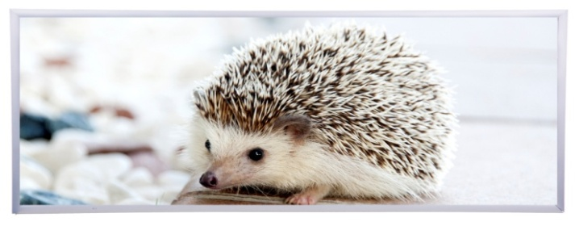
Jednoga dana, vidjeli nismo
Ježić je, kažu, dobio pismo,
Medeno pismo, pričao meca,
Stiglo u torbi poštara zeca
Adresa kratka, slova ko jaja:
„Za druga Ježa na kraju gaja‟.
One sunny day, so the story is told
Hedgemond was given a letter so bold
Sweet words were delivered straight from the sack
Of postman rabbit, in uniform black
The address was short, the letters so neat:
„For Hedgemond hunter at 3, Meadow street ‟.

Slide 37
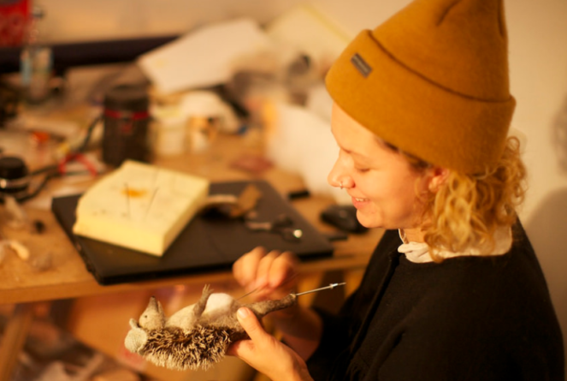
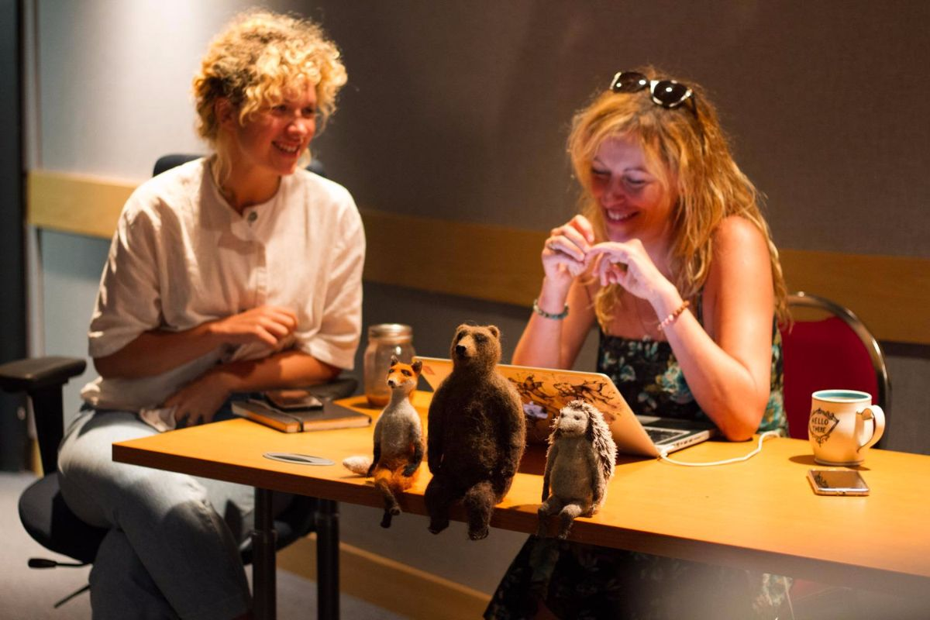
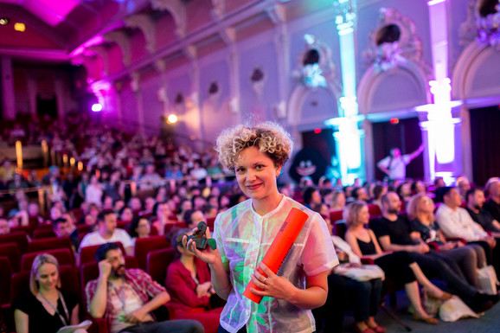
Eva Cvijanović: Nagrade su dokaz da se svaki trud isplati (Izvor: Bonobostudio)

Slide 38
Izvori
Bnbstudio–www. In: http://bonobostudio.hr/hr/film/in_production/hedgehog_s_home
Ćopić (2009): Ćopić, Branko. Ježeva kućica. Zagreb: Naša djeca.
Ćopić (2011): Ćopić, Branko. Hedgehog’s Home (prev. S. D. Curtis). London: ISTORS Books.
Ćopić (2014): Ćopić, Branko. Ježeva kućica, Banjaluka – Beograd – Tuzla: Biblioteka Mali princ.
Nbf.eng–www. In: http://www.nfb.ca/film/hedgehogs_home
Nbf.hr–www. In: http://www.nfb.ca/film/jezeva-kuca-hedgehogs-home/
Rastko–www. In: https://www.rastko.rs/rastko-bl/umetnost/knjizevnost/bcopic/bcopic-jezurka_l.html Vimeo.eng–www. In: https://vimeo.com/ondemand/hedgehogshome
Vimeo.hr–www. In: https://vimeo.com/ondemand/jezevakuca

Slide 39
Literatura
Baker (2006): Baker, Mona. A coursebook on translation. In: Other Words. New York: Routledge.
Curtis (2011): Curtis, Susan D. Translating „Hedgehog’s Home‟ by Branko Copic. Ivir (1984): Ivir, Vladimir.Teorija i tehnika prevođenja, Novi Sad: Zavod za izdavanje udžbenika u Novom Sadu.
Jakšić (2012). Jakšić, Mirta. Translating Children’s Literature: Case Study of „Ježeva kućica‟ by Branko Ćopić. Osijek: Sveučilište J. J. Strossmayera .
Nida (2000): Nida, Eugene Albert. Principles of Correspondence. In: Ed. Lawrence Venuti. The Translation Studies Reader. London: Routledge.
Oittinen (2000). Oittinen, Riitta. Translating for Children, New York: Garland Publishing.
Raffel (2010). Raffel, Burton. Art of Translating Poetry, Pensylvania State University: Penn State Press.
Wierzbicka (1985). Wierzbicka, Anna. Different Cultures, Different Languages, Different Speech Acts. Polish vs. English. In: Journal of Pragmatics, 9, 145–178.

Slide 40
Hvala na pažnji!

